Slide 1
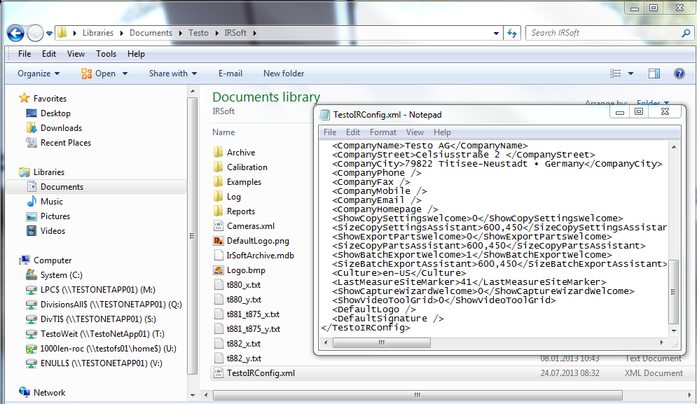
1.
3.
4.
2.
Go to this directory
Open „TestoIRConfig.xml“ by using the right click of the mouse an choose open with – open the file with Notepad
Search for the item “LastMeasureSiteMarker”
and change the counter to the highest ID you already have in your archive

